Slide 1


Slide 2

Identification of Slicks from Satellite Images
Satellite Images
367
Members
4
Data samples
4000
Duration 48H

Slide 3



Value Addition
Time
Drastic decrease in Time
Interpretation Accuracy
Better geological representation
Cost
Significant decrease in cost

Slide 4
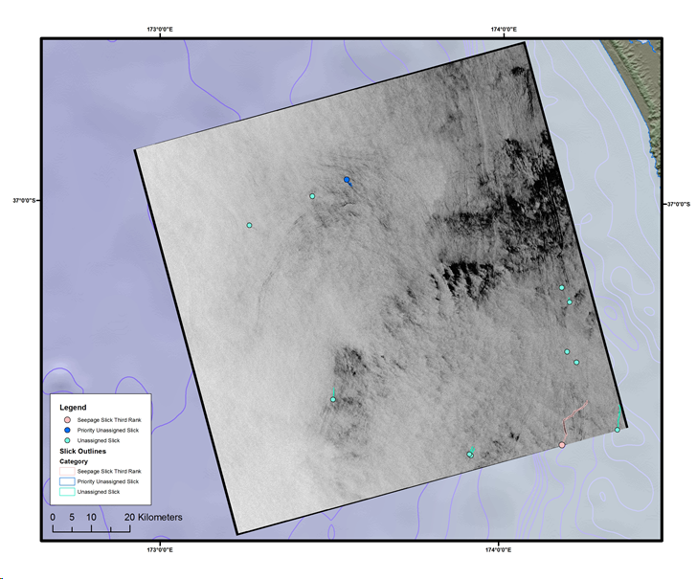

Slide 5
Problem formulation
... as a segmentation problem
Pixelwise detection, predict 256 x 256 pixels at a time.
Unet w/ binary cross entropy and dice loss.
Highly unbalanced data --> poor performance
... as a classification problem
Given images of slicks and non-slicks, make a CNN with binary classification
~4000 samples, Lots of to get more data augmentation
78% accuracy on test set (15% of data)

Slide 6
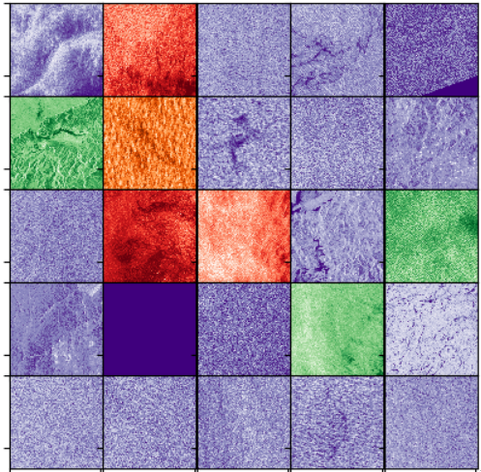
Prediction examples
Good
Purple = true negative
Green = true positive
Bad
Red = false positive
Orange = false negative
In general: More false positive than false negative. Precision is lower than recall.
For screening purposes, this might be fine.

Slide 7
Conclusion and what we have learned
Neural networks good potential to detect oil slicks
Class imbalance problem
Start easy and progress to more difficult problems
Girls Just Wanna Have Fun, on the karaoke machine

Slide 8




